Slide 1
Software Project Management Plan
Chapter 5
COCOMO

Slide 2
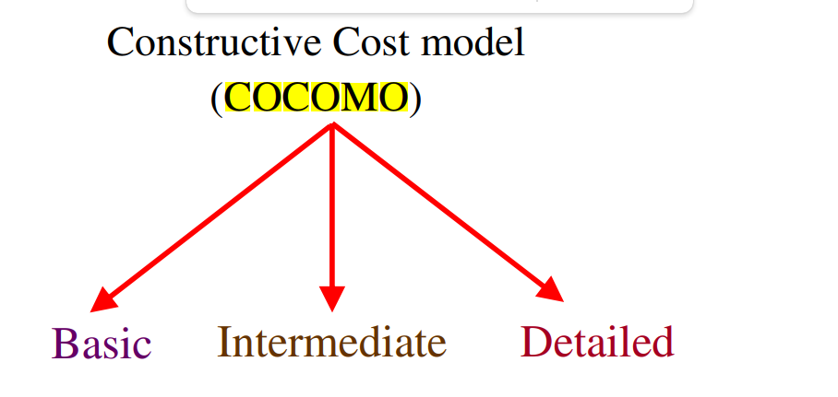

Slide 3
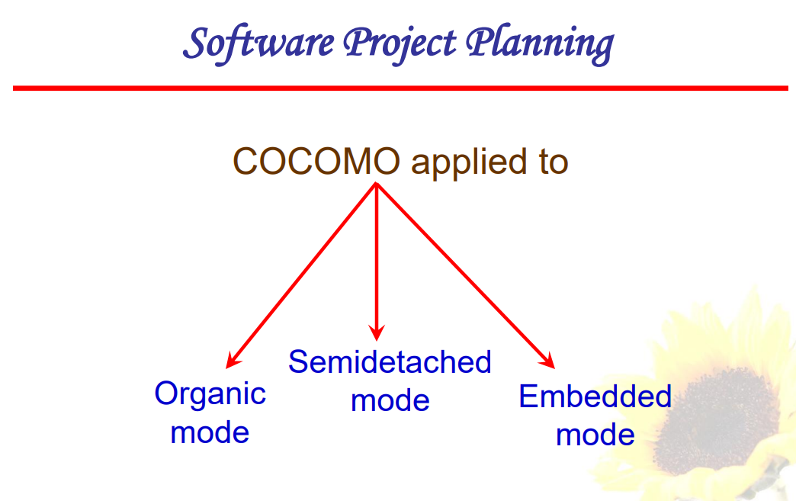

Slide 4
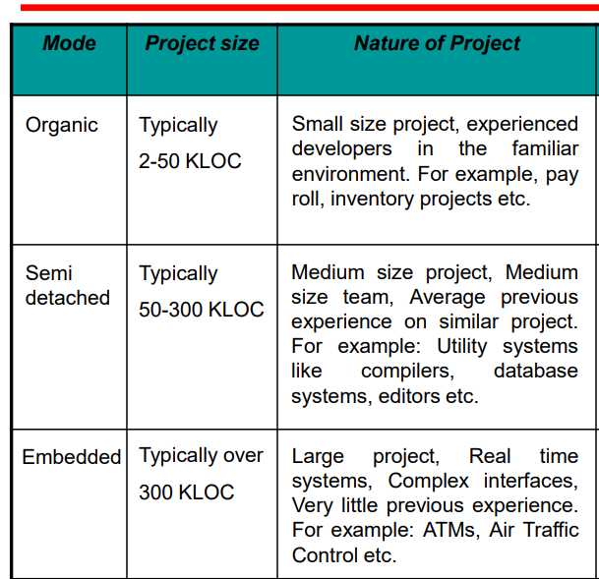

Slide 5
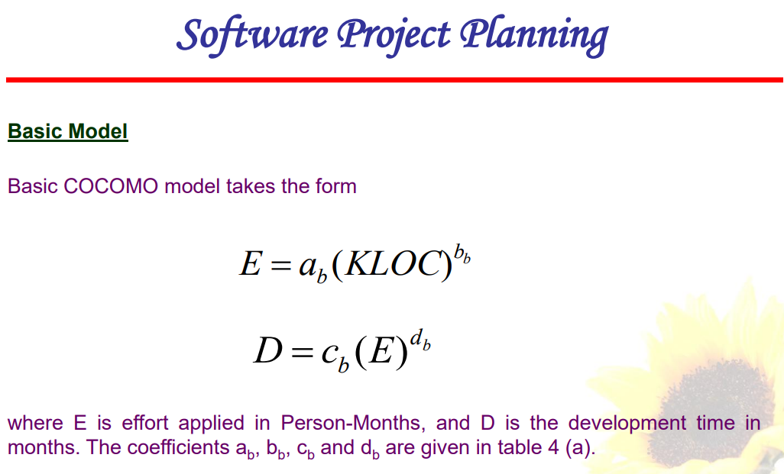

Slide 6
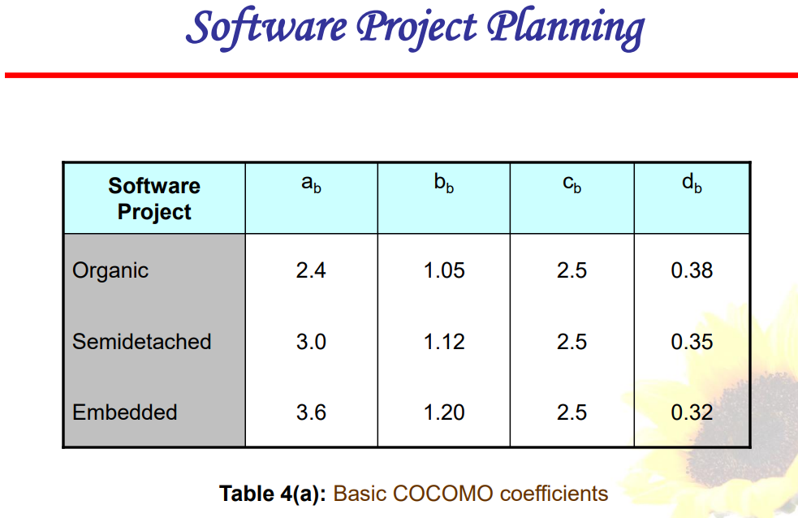

Slide 7
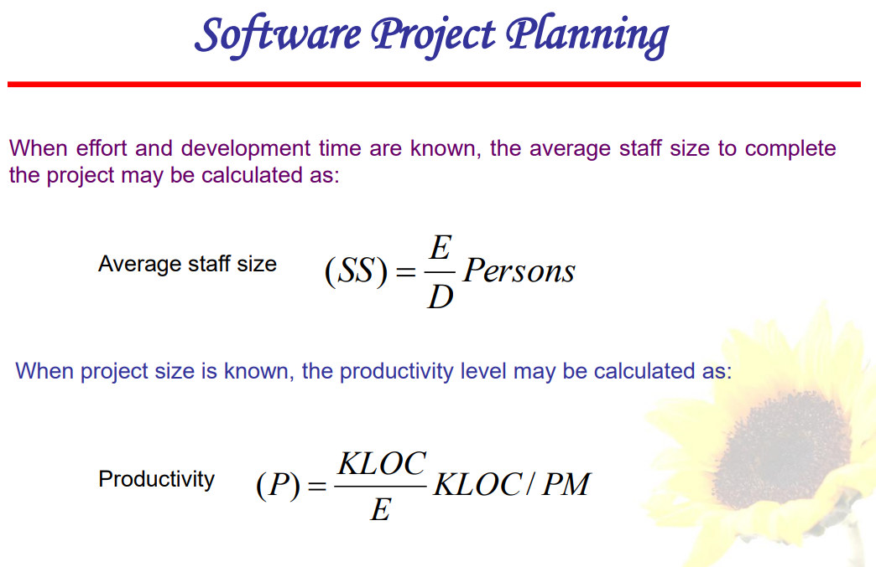

Slide 8
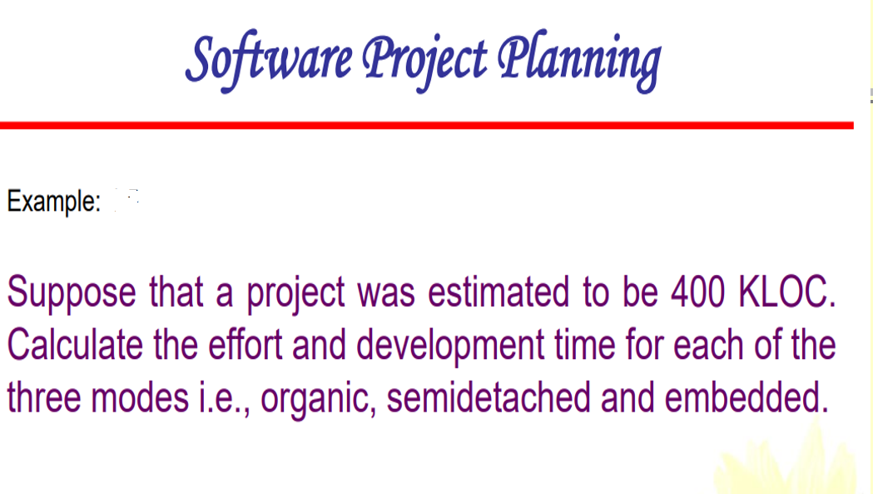

Slide 9
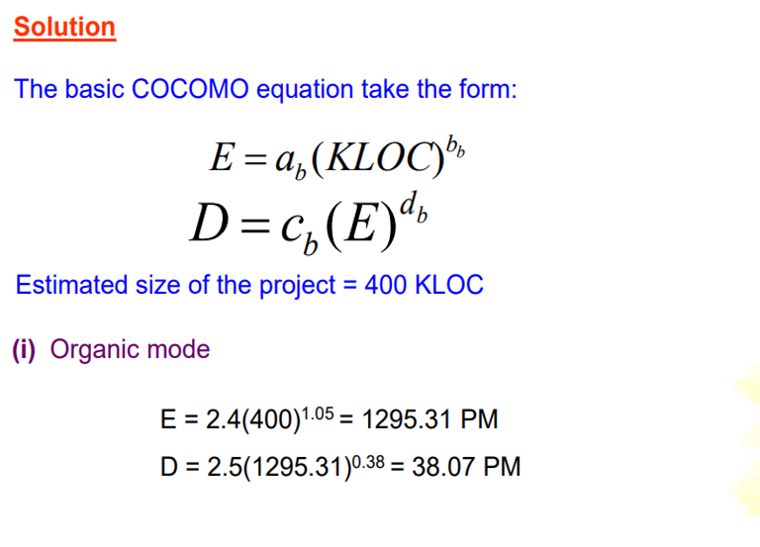

Slide 10
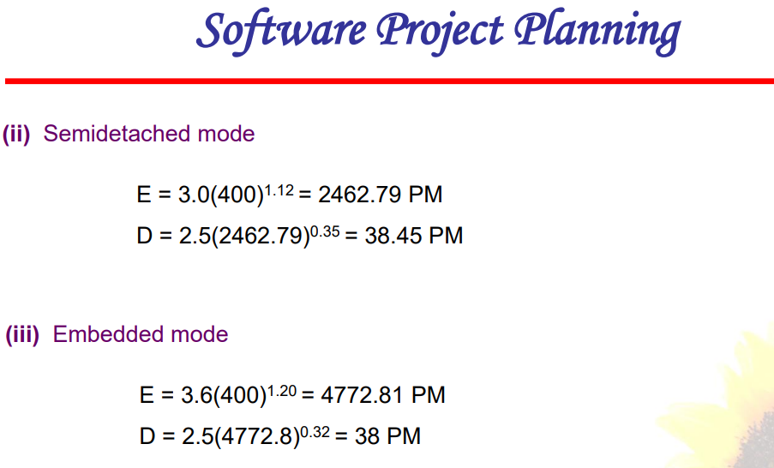

Slide 11
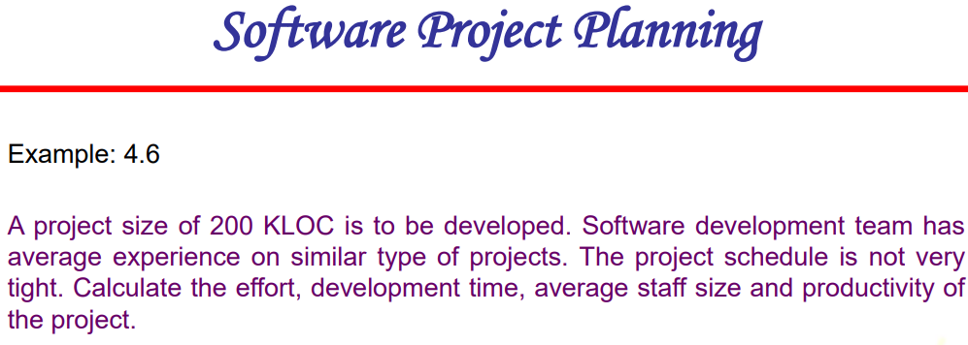

Slide 12
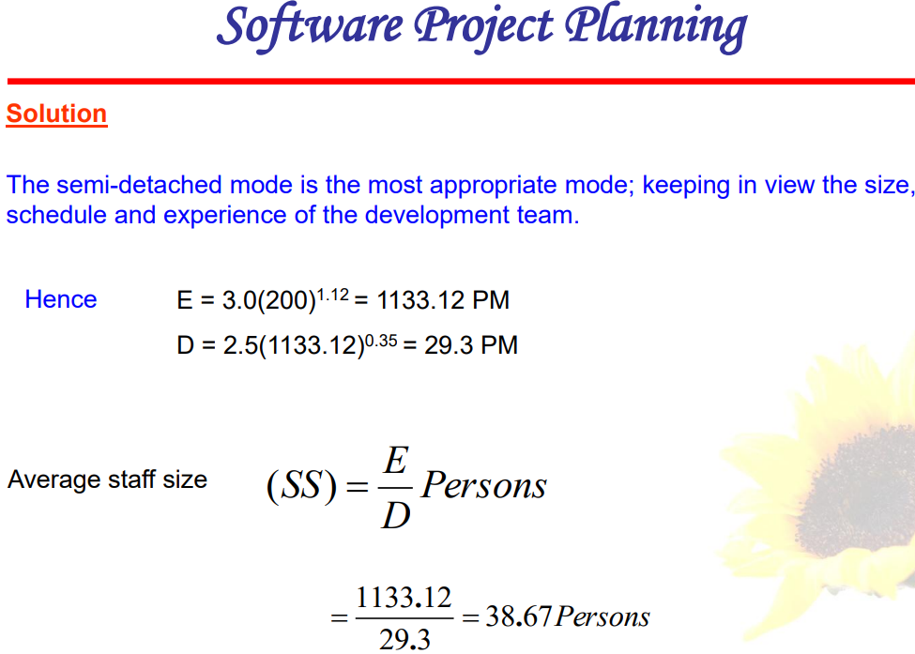

Slide 13
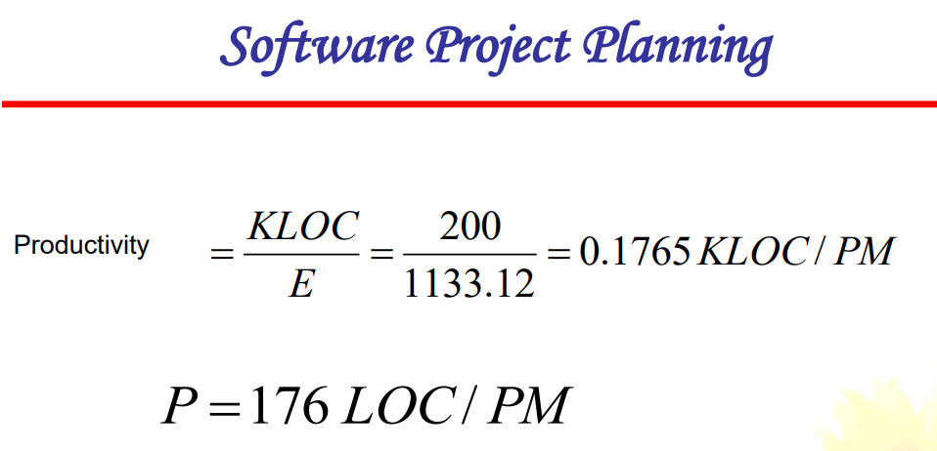

Slide 14
Software Project Planning
COCOMO has three different models that reflect complexity
  1. Basic Model
  2. Intermediate Model
  3. Detailed Model
Similarly, there are three classes of software projects.
    Organic (Basic ) mode in this mode, relatively simple, small software projects with a small team is handled. Such team should have good application experience to less rigid requirements.
  Semi-detached (Intermediate) projects in this class intermediate project in which team with mixed experience level are handled. Such project may have mix of complex and simple requirements.
  Embedded (Detailed) projects in this class, project with tight hardware, software and operational constraints are handled.

Slide 15
Software Project Planning
Intermediate Model
  This estimation model makes use of set of “Cost Driver Attributes” to compute the cost of software.
  I. Product attributes
    a. required software reliability (RELY) b. size of application data base (Data) c. complexity of the product (CPLX)
  II. Hardware attributes
    a. run-time performance constraints (TIME) b. memory constraints (STOR)
    c. volatility of the virtual machine environment (VIRT) d. required turnaround time (TURN)
  III. Personnel attributes
    a. analyst capability (ACAP) b. software engineer capability (PCAP) c. applications experience (AEXP) d. virtual machine experience (VEXP) e. programming language experience (LEXP)
  IV. Project attributes
    a. use of software tools (TOOL ) b. application of software engineering methods (MODP)
    c. required development schedule (SCED )
  Each of the 15 attributes is rated on a 6 point scale that ranges from "very low" to "extra high" (in importance or value).

Slide 16
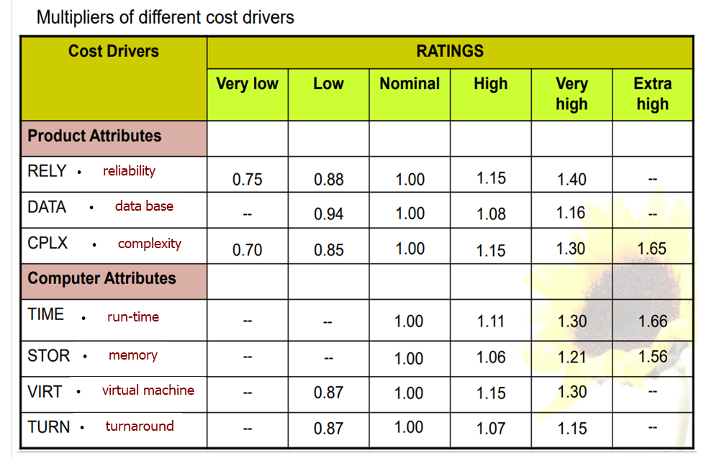

Slide 17
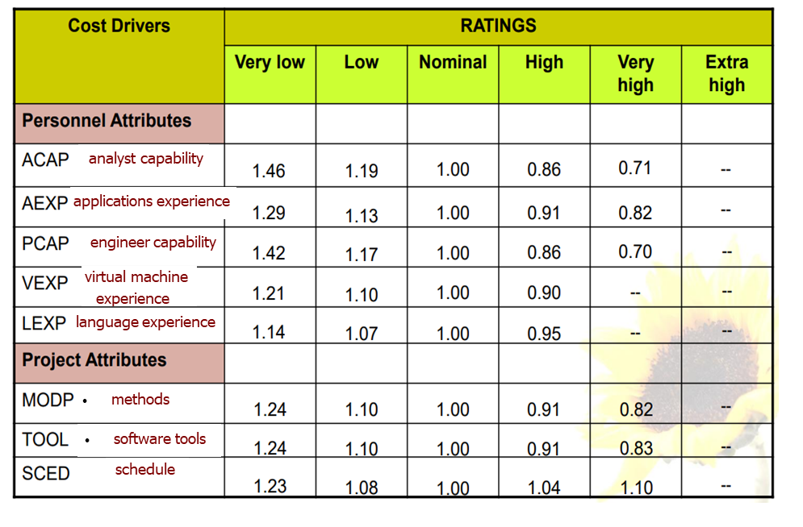

Slide 18
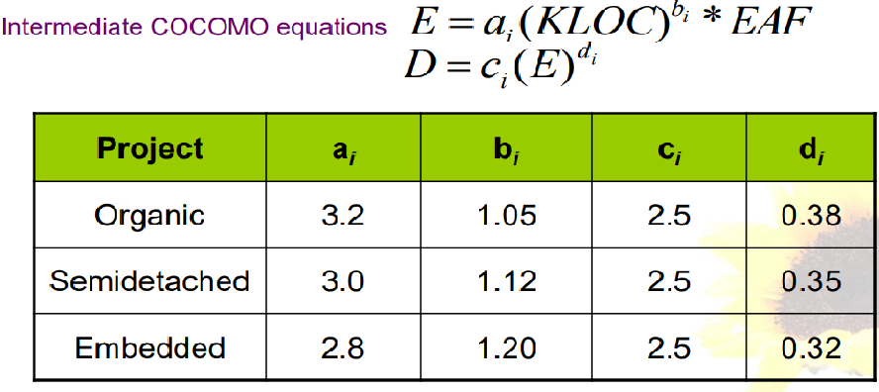
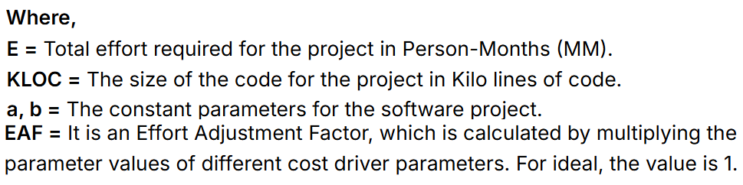

Slide 19
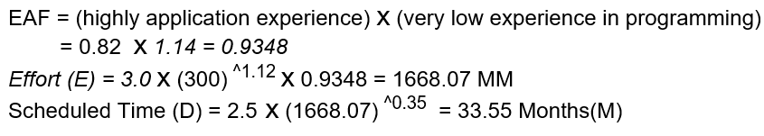
Software Project Planning
Example: For a given project was estimated with a size of 300 KLOC. Calculate the Effort, Scheduled time for development by considering the developer having high application experience and very low experience in programming.
Solution –
  Given the estimated size of the project is: 300 KLOC
  Developer having highly application experience: 0.82 (as per above table)
  Developer having very low experience in programming: 1.14(as per above table)
  Effort (E) = a x (KLOC)^{^b} x EAF PM
  D = c x (Effort) ^{^d}

Slide 20
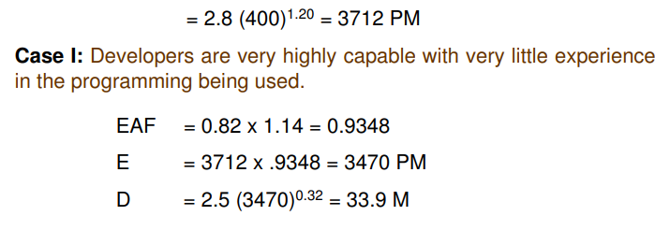
Software Project Planning
Example: A new project with estimated 400 KLOC embedded system has to be developed. Project manager has a choice of hiring from two pools of developers: Very highly capable with very little experience in the programming language being use. Or developers of low quality but a lot of experience with the programming language. What is the impact of hiring all developers from one or the other pool ?
Solution
  This is the case of embedded mode and model is intermediate COCOMO..
  Effort (E) = a x (KLOC)^{^b} x EAF PM
  D = c x (Effort) ^{^d}

Slide 21
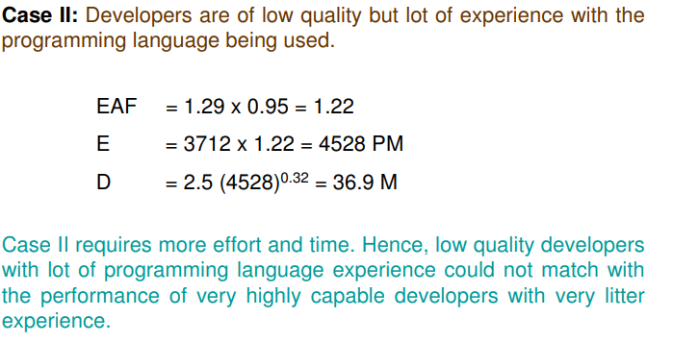
Software Project Planning

Slide 22
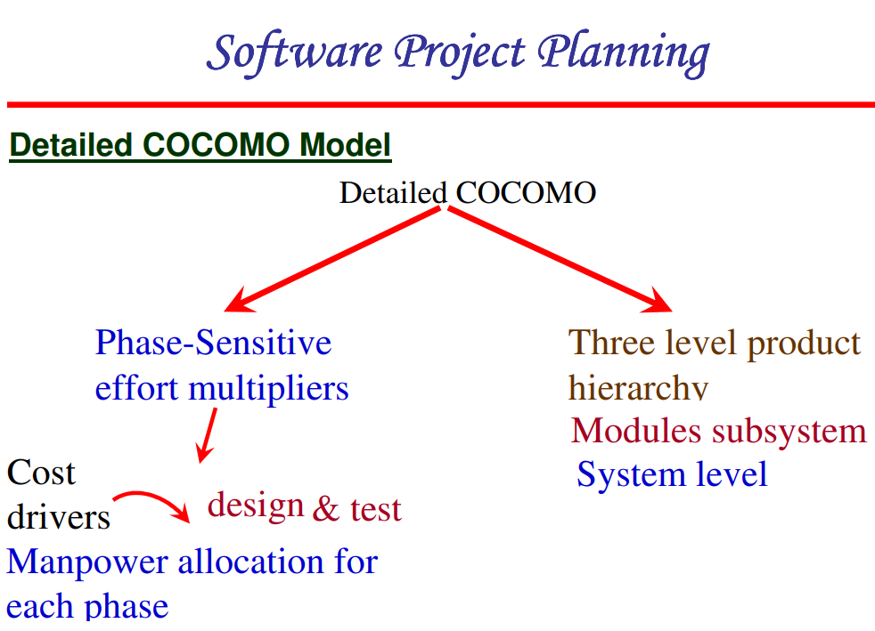

Slide 23
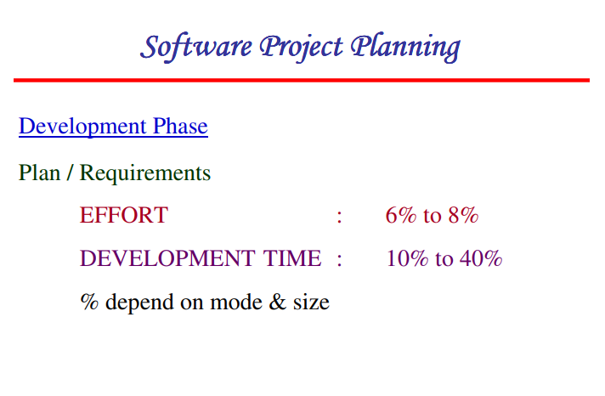

Slide 24
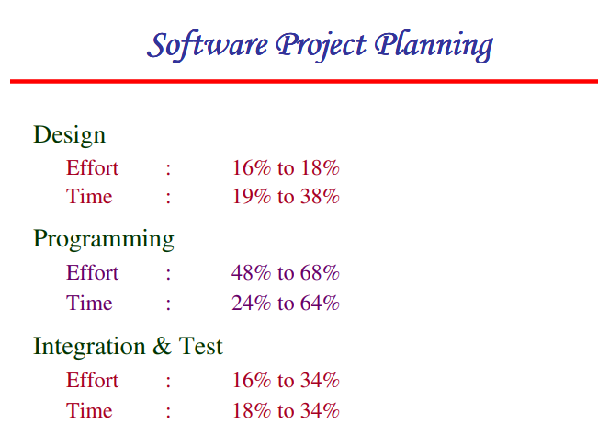

Slide 25
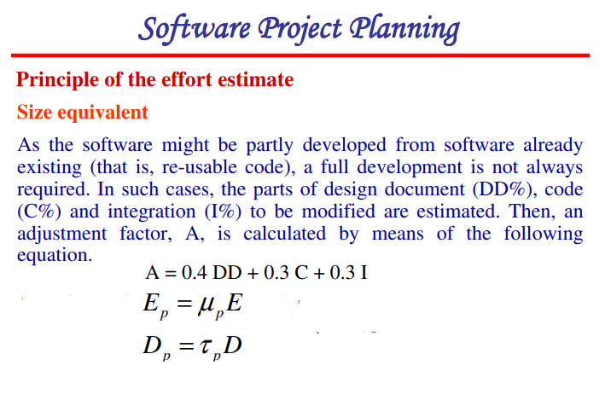

Slide 26
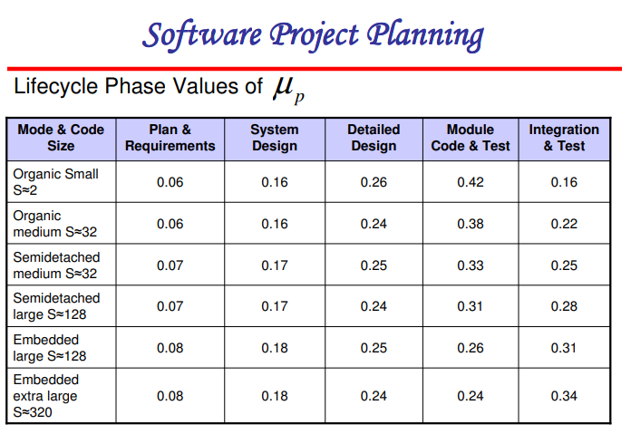

Slide 27
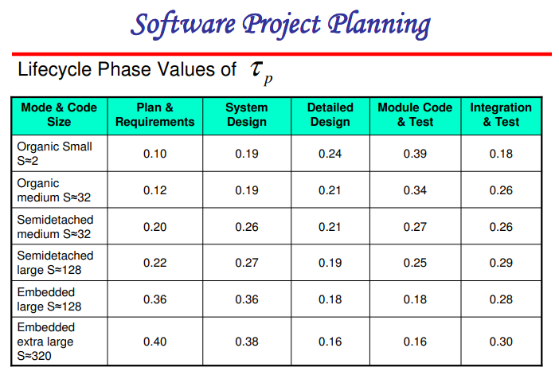

Slide 28
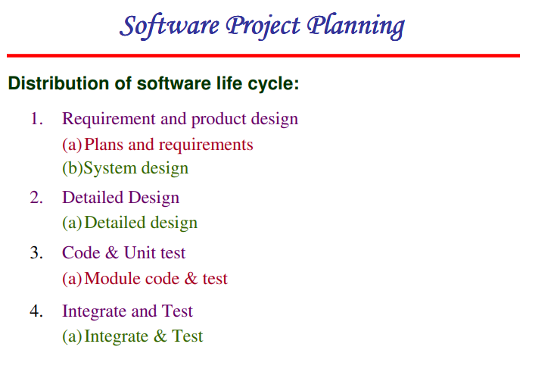

Slide 29
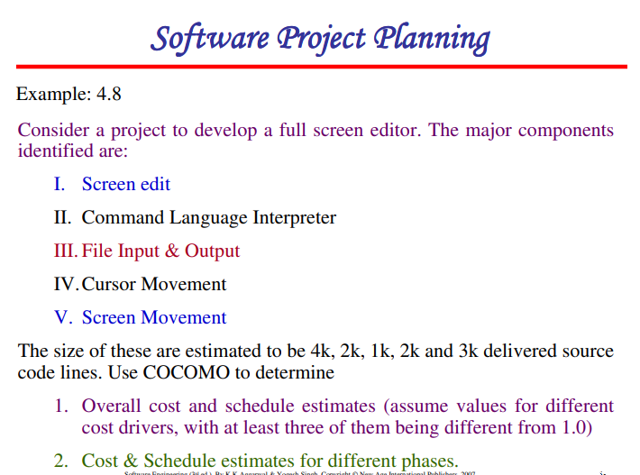

Slide 30
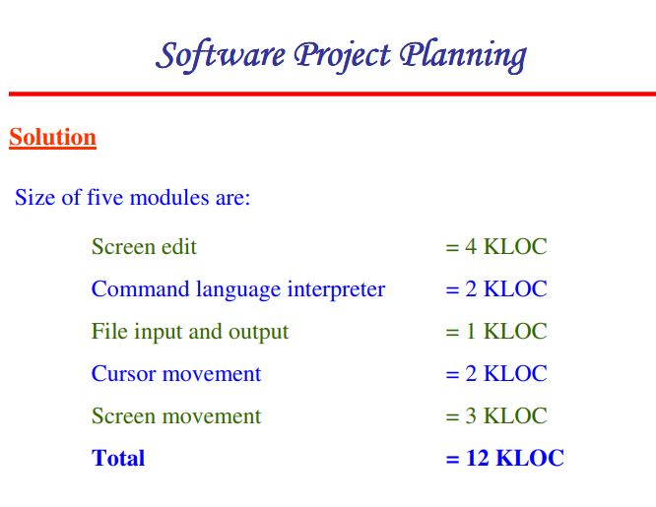

Slide 31
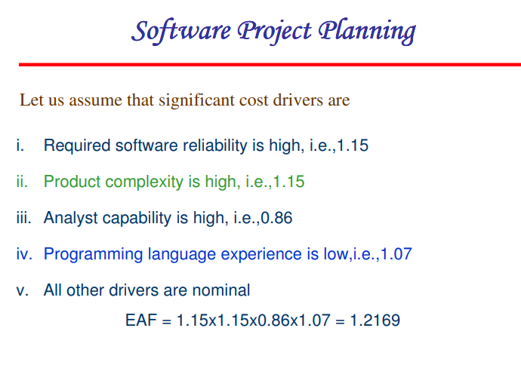

Slide 32
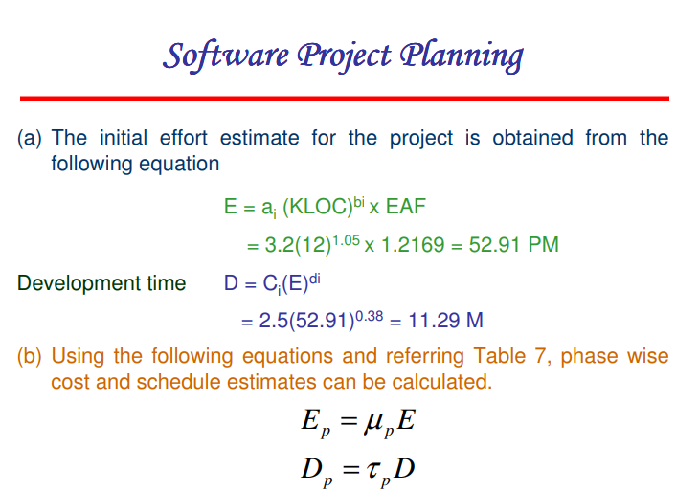

Slide 33
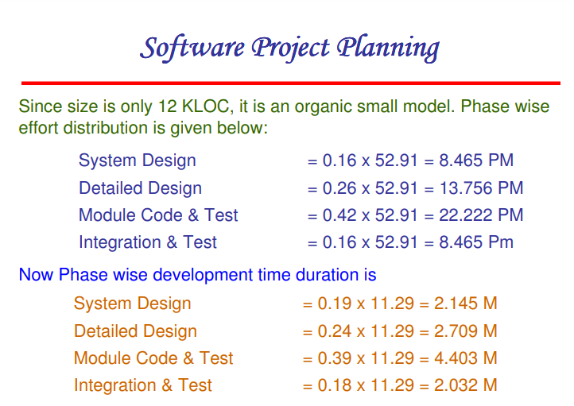

Slide 34
End of Presentation

